Slide 1
VEHICLE DETECTION

Slide 2
CONTEXT
Abstract
Introduction
Process
Haar Features
Classifier Algorithm for Car Detection
Conclusion

Slide 3
ABSTARCT
This project deals with Vehicle detection using OPENCV with the help of Haar-Like feature. Haar-Like features contains Line and Edge Features which help in Vehicle recognition Accurately by pattern making. The Algorithm for Vehicle Detection can be divided into two phases: one is Procedure Generation and second is Procedure Verification. In the first phase, Algorithm checks the given object by observing the edge features and line features present in object or not.or simply the patterns which help in detecting a car are checked.in the second step if the pattern is found then the object is recognized as vehicle otherwise the detection of the vehicle is not done.
OPENCV is used as it is Computer Vision Library which is used to recognize an image OPENCV helps in image processing with the help of different methods like cvtColor which helps to convert pixels color of an image to required color format. OPENCV helps the Vehicle detection algorithm by avoiding the data which is not required in image processing.

Slide 4
Introduction:
OpenCV:
Open cv is an important Computer Vision Library used to read (or) recognize an image.
Opencv is used to read different levels of colours in a pixel and helps in distinguishing one colour in a pixel to another.
Opencv helps in image processing with the help of different
methods like cvtColor which helps to convert pixels colour of
an image to required format colour.
The main purpose of opencv is to aid the algorithm in object detection by avoiding the data which is not required to process.

Slide 5
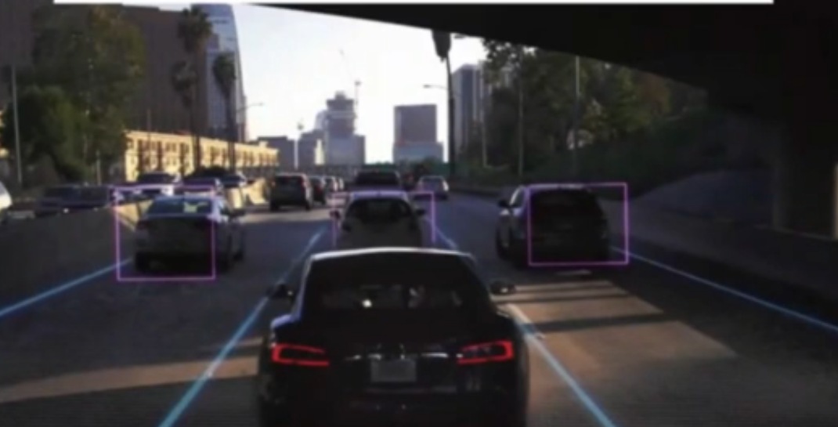
OpenCV
Opencv is similar to eyeballs for humans which helps to sense the objects around us and to helps in recognizing the obstacle and perform action accordingly.
Opencv helps the Automatic cars
to detect the objects.

Slide 6
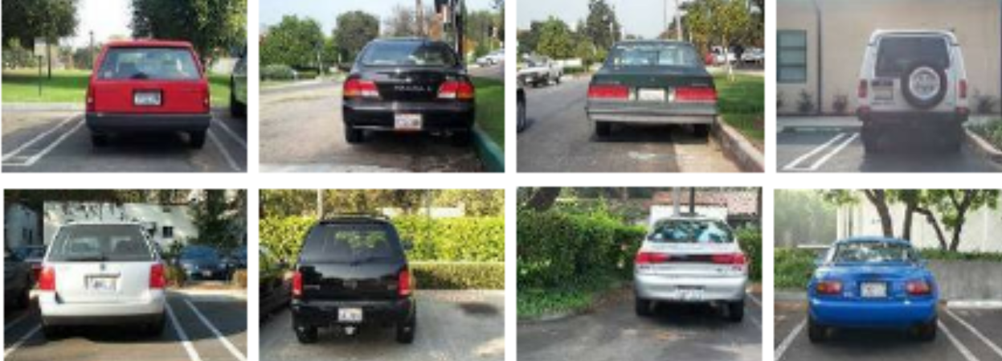
Process
Step1: Collect lot of car images
Dataset is large collection of raw data or it can be simply considered as reference for detecting Objects accurately without any error.
Larger the Dataset larger the experience it is similar to solving different problems of same concept. which helps machine to recognize the objects by considering all the factors or features to judge an object.
In opencv we use a method called imread(img_file) to read an image.

Slide 7
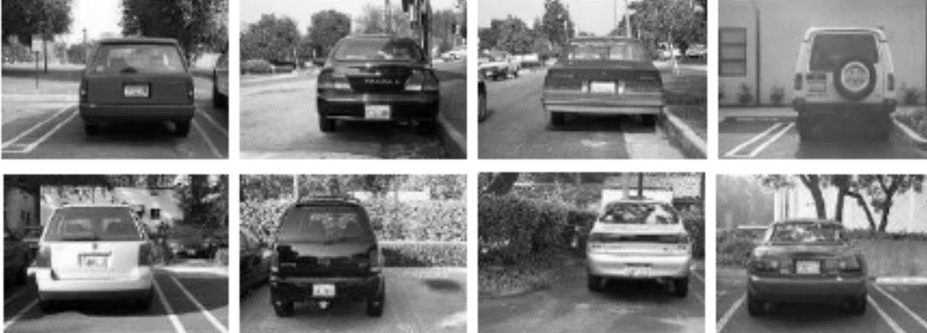
Process:
Step2: Convert all colours in pixel to Black and White
We should convert all the colours of pixels into white and Black as it makes some portion of object lighter and other portions look fader which helps the algorithm to recognize the objects faster by ignoring the colour data of the pixels as our main concern is on recognizing the Object.
This helps the algorithm to realise the object fastly and Opencv contains cvtcolor() to desired format.

Slide 8


Haar Features:
Haar features consists of edge features,line features.
A Haar-like feature is represented by taking a rectangular part of an image and dividing that rectangle into multiple parts. They are often called as black and white adjacent rectangles.
When an image is converted to Black and White then some portion of the image is darker than others dark and bright portions appear adjacently.

Slide 9
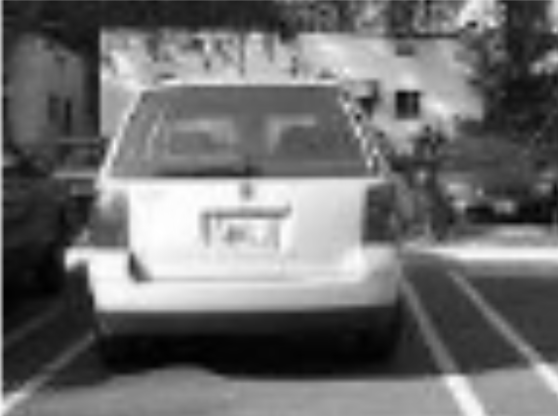
Haar Features:

Slide 10
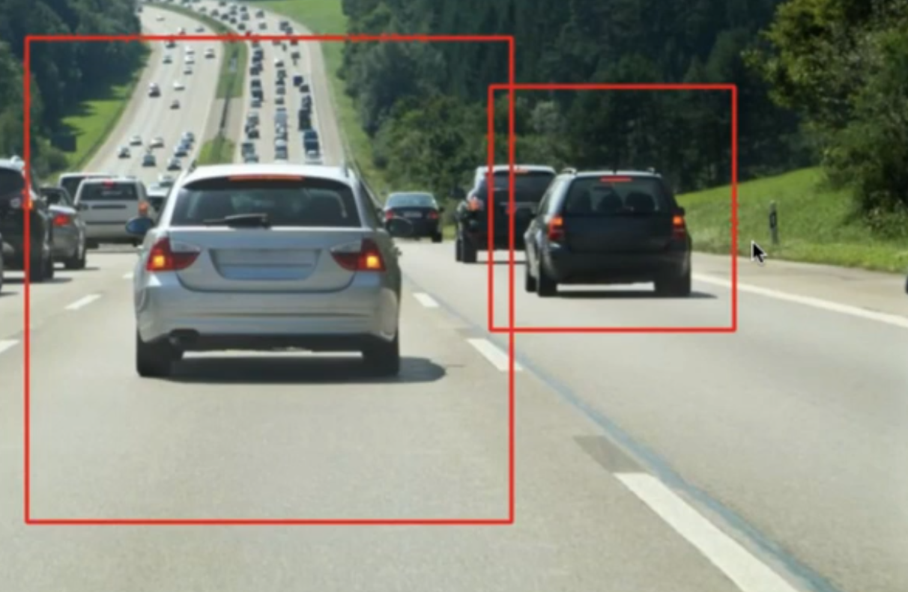
Classifier Algorithm for Car Detection:
In above Figure(Car),the colour of Rear Window is black and the colour of the bumper body is brighter and dark and bright portions appear adjacent in car so the Haar features help to recognize whether the object is Car or not.
CascadeClassifier method is used which reads the algorithm which consists of all the Haarfeatures and detects all the Cars present in the image with the help of Haarfeatures and gives the car layout accurately .
Finally Rectangle method is used for layout on the Car.

Slide 11
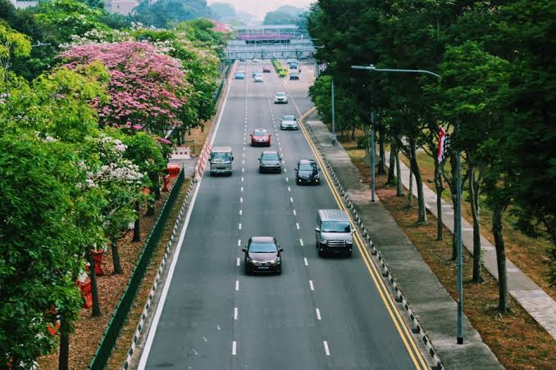
INPUT

Slide 12
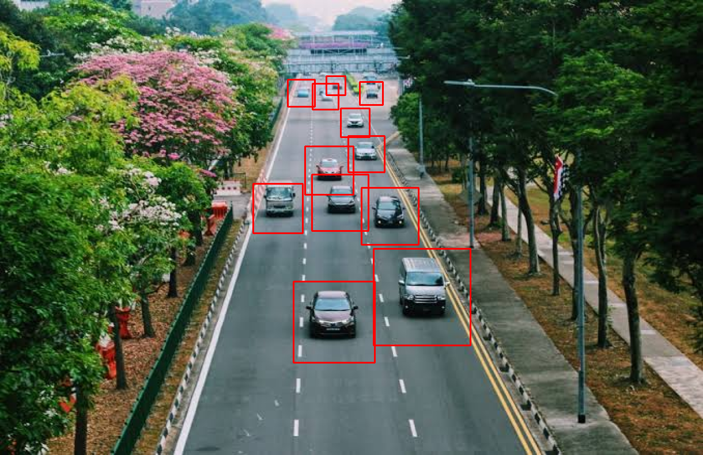
OUTPUT

Slide 13
CONCLUSION
This project proposed a method where Vehicle Detection is done by Haar-like Feature and the Symmetric Feature. Haar Feature have a Stronger and Clearer Edge and is an Important feature for Vehicle Detection. Symmetric Feature is an Important Feature which helps to detect the Vehicle based on its Symmetric nature. And Symmetric nature of the vehicle can be observed when the car is nearer to the Camera. The proposed Algorithm is fast when compared to the other algorithms as we can see the speed of the execution for vehicle Detection. The Algorithm was Proposed to detect vehicle on Real life system. But it has limit of detecting the Vehicles on a Single Camera.
Sometimes error may be generated as we know that traffic on the roads change over time. so the Algorithm must be trained in order to become more robust.

Slide 14
THANK YOU

